Slide 1
Physics Thermodynamics Review (Ch. 17-19)
Kenneth Tandjung

Slide 2
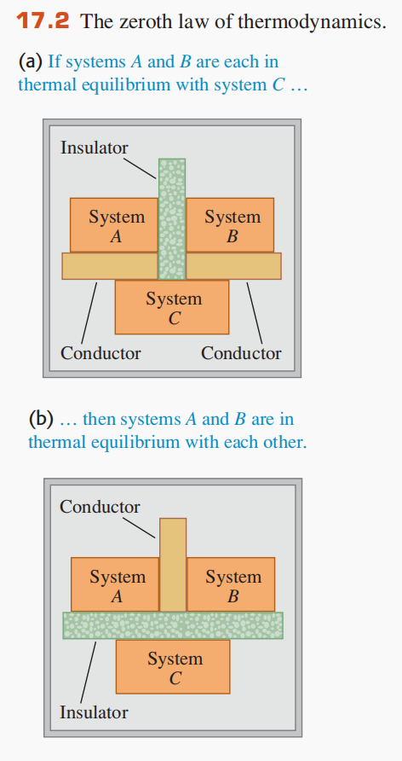
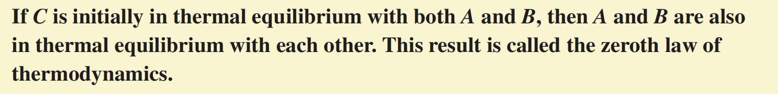
Two systems are in thermal equilibrium iff they have the same temperature

Slide 3
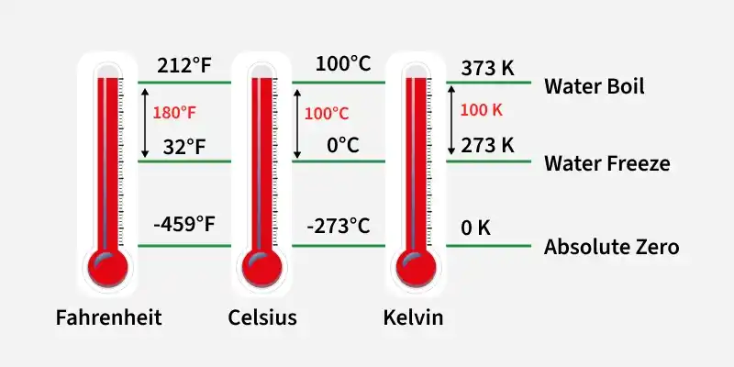

Slide 4
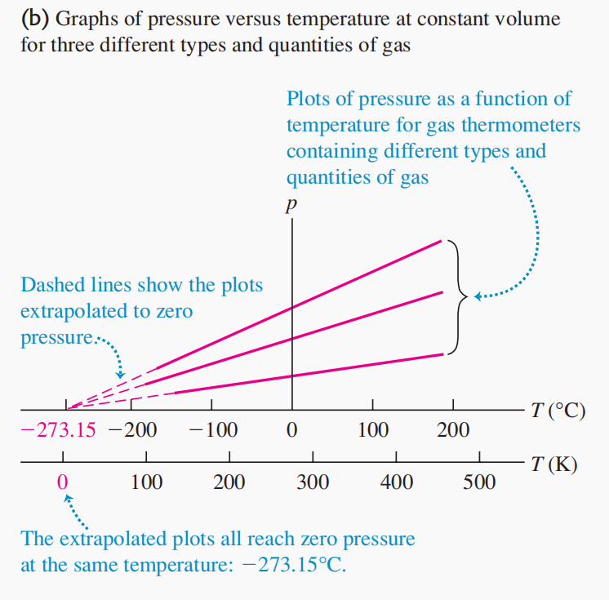

Slide 5
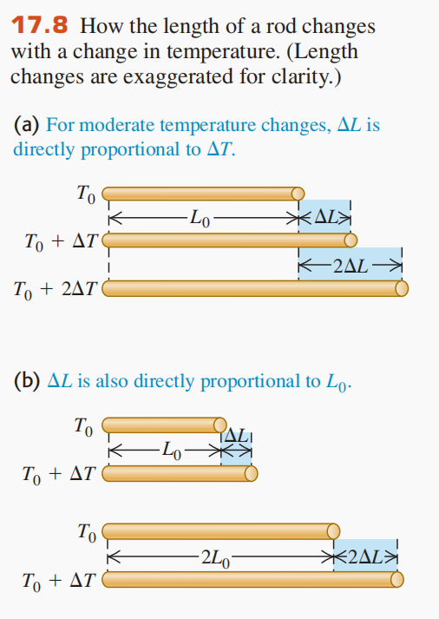
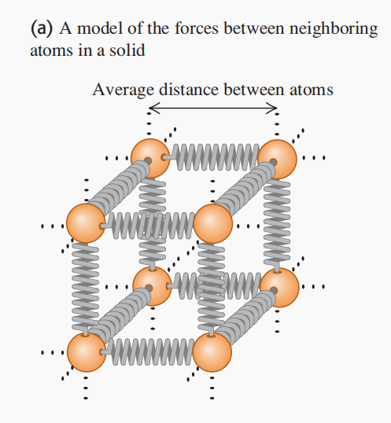
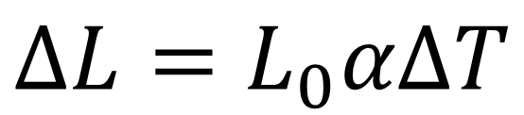
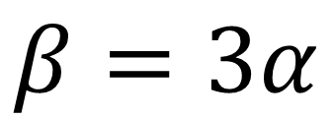
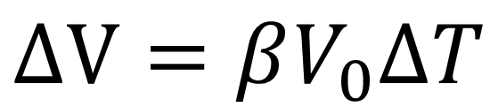
$$ΔL=L_{0}αΔT$$
$$ΔV=βV_{0}ΔT$$
$$β=3α$$

Slide 6
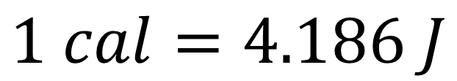
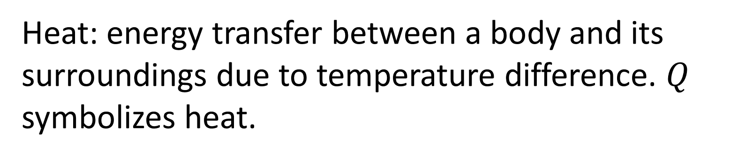
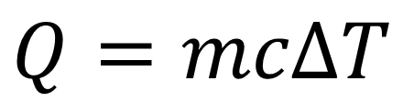
Heat: energy transfer between a body and its surroundings due to temperature difference. $Q$ symbolizes heat.
Calorie: a unit of heat defined as the amount of heat required to raise the temperature of 1 gram of water from 14.5°C to 15.5°C. A calorie in foods is actually 1 kcal.
$$Q=mcΔT$$
$$1 cal=4.186 J$$

Slide 7
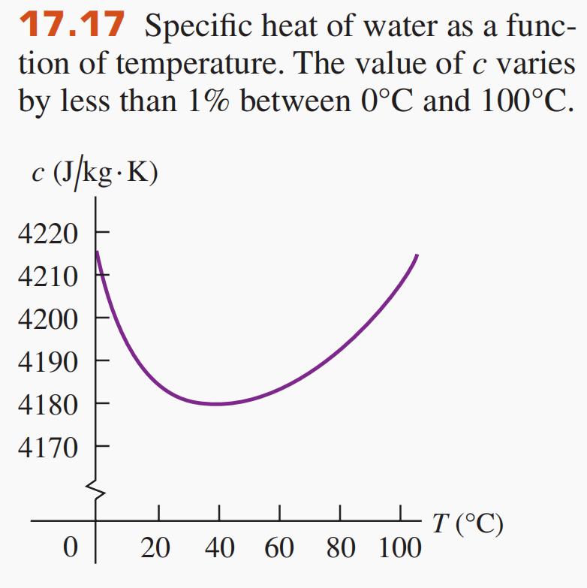

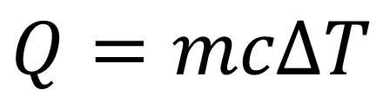

$$Q=mcΔT$$
$$ⅆQ=mc dT$$
$$c=\frac{1}{m}\frac{dQ}{dT}$$
$c$ (heat capacity) is not constant, it depends on the temperature.

Slide 8
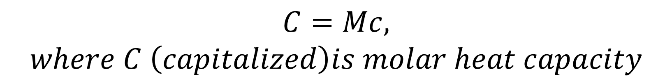
$$m=nM,$$
$$where n is number of moles and M is molecular mass$$
$$C=Mc,$$
$$where C \left(capitalized\right)is molar heat capacity$$

Slide 9
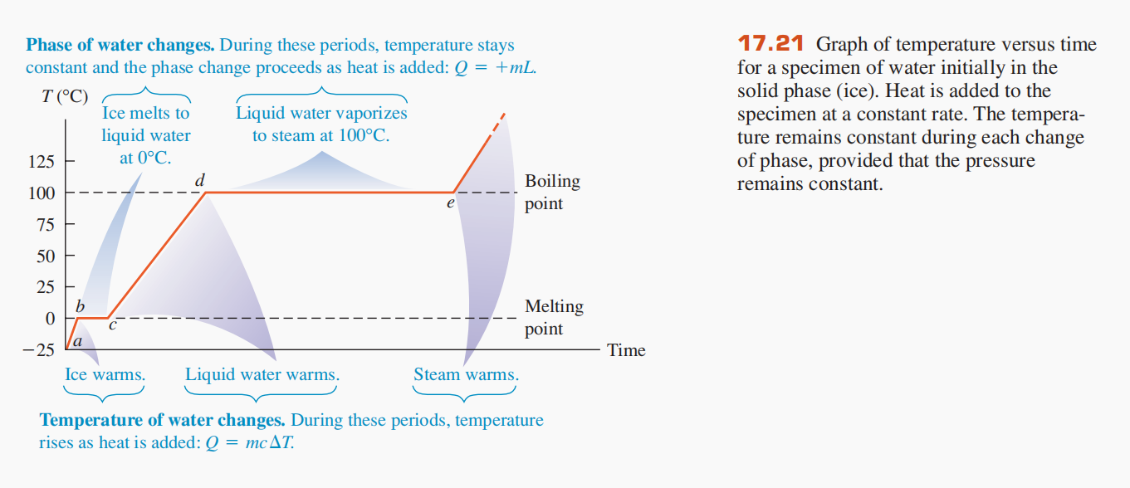
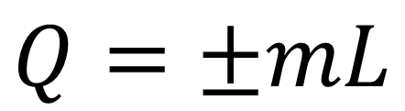
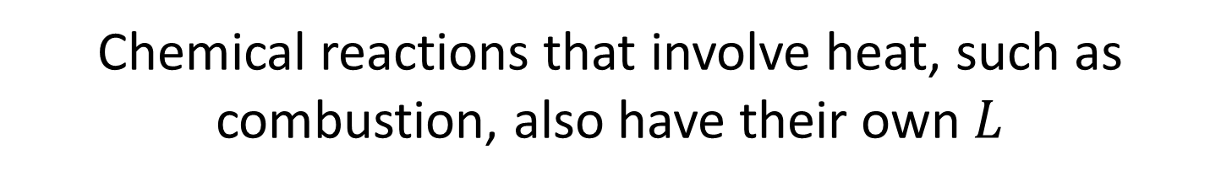
$$Q=±mL$$
Chemical reactions that involve heat, such as combustion, also have their own $L$

Slide 10
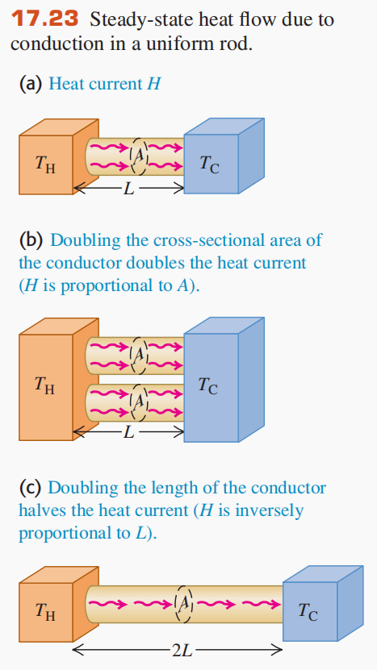
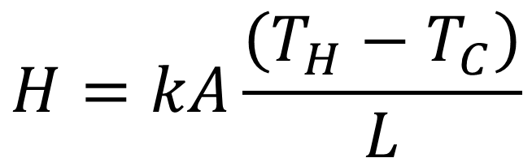
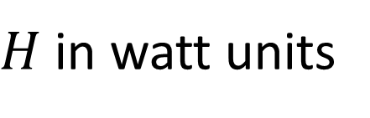
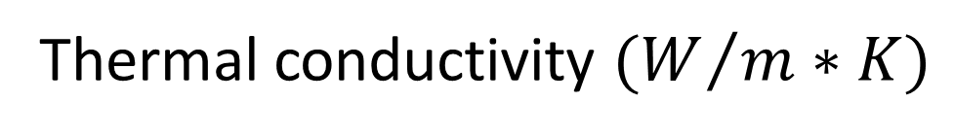
$$H=kA\frac{\left(T_{H}−T_{C}\right)}{L}$$
Temperature gradient
Thermal conductivity $(W/{m∗K})$
$H$ in watt units

Slide 11
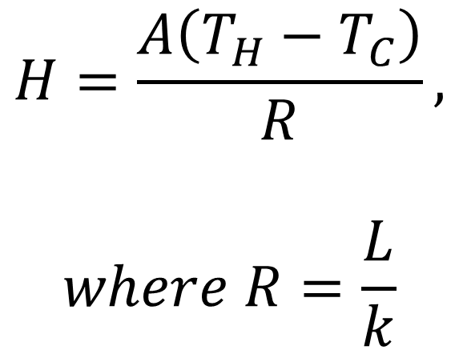
$$H=\frac{A\left(T_{H}−T_{C}\right)}{R},$$
$$where R=\frac{L}{k}$$

Slide 12
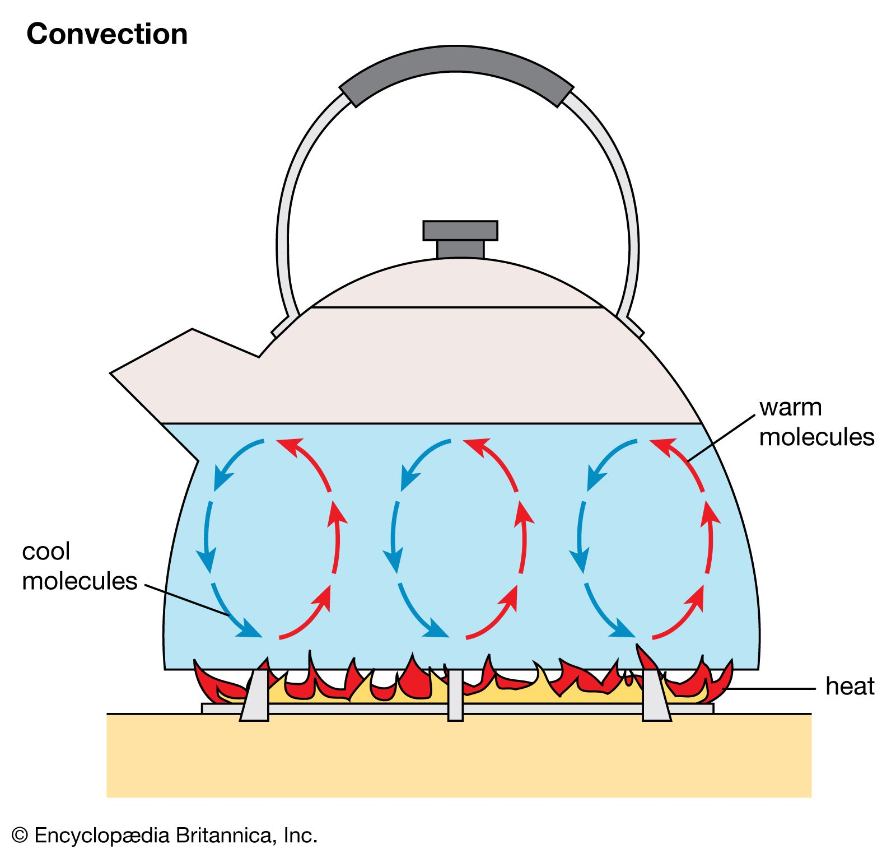
Convection is the transfer of heat by mass motion of a fluid from one region of space to another

Slide 13
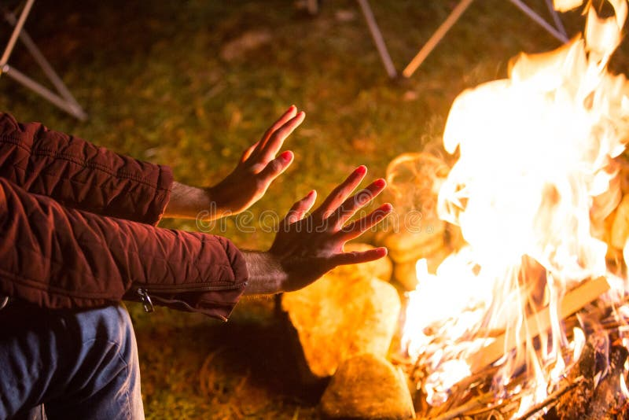
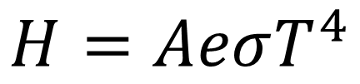


Radiation is the transfer of heat by electromagnetic waves such as visible light, infrared, and ultraviolet radiation.
$$H=AeσT^{4}$$
$$σ=5.67 ∗{10}^{−8}W/m^{2}∗K^{4}$$
$$0≤e≤1$$
$$H_{net}=Aeσ{(T}^{4}−T_{s}^{4})$$

Slide 14
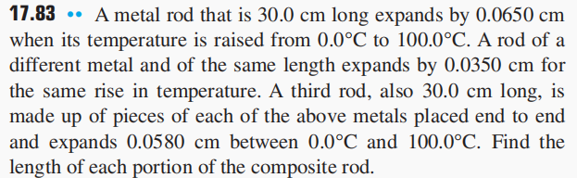
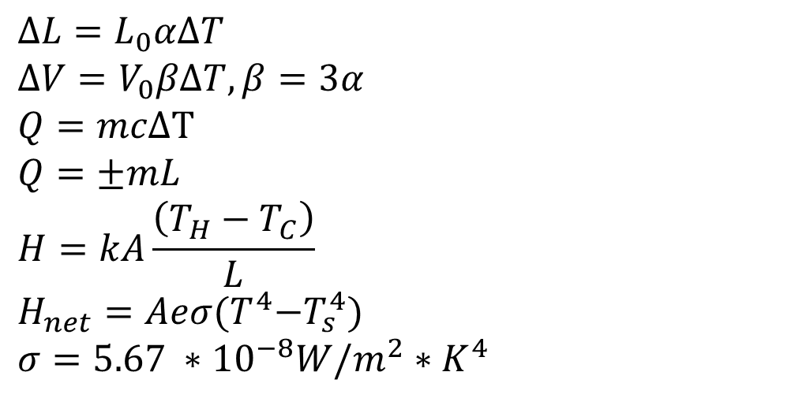
$$ΔL=L_{0}αΔT$$
$$ΔV=V_{0}βΔT, β=3α$$
$$Q=mcΔT$$
$$Q=±mL$$
$$H=kA\frac{\left(T_{H}−T_{C}\right)}{L}$$
$$H_{net}=Aeσ{(T}^{4}−T_{s}^{4})$$
$$σ=5.67 ∗{10}^{−8}W/m^{2}∗K^{4}$$

Slide 15
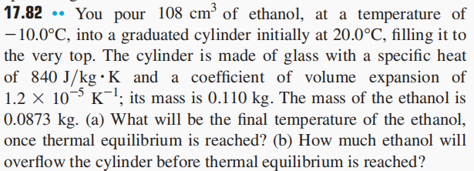
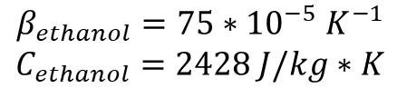
$$ΔL=L_{0}αΔT$$
$$ΔV=V_{0}βΔT, β=3α$$
$$Q=mcΔT$$
$$Q=±mL$$
$$H=kA\frac{\left(T_{H}−T_{C}\right)}{L}$$
$$H_{net}=Aeσ{(T}^{4}−T_{s}^{4})$$
$$σ=5.67 ∗{10}^{−8}W/m^{2}∗K^{4}$$
$$β_{ethanol}=75∗{10}^{−5} K^{−1}$$
$$C_{ethanol}=2428 J/kg∗K$$

Slide 16
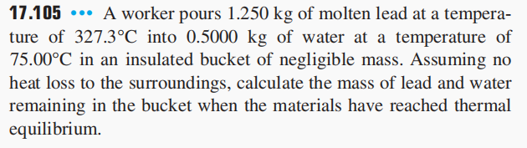
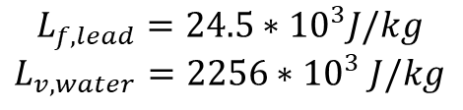
$$ΔL=L_{0}αΔT$$
$$ΔV=V_{0}βΔT, β=3α$$
$$Q=mcΔT$$
$$Q=±mL$$
$$H=kA\frac{\left(T_{H}−T_{C}\right)}{L}$$
$$H_{net}=Aeσ{(T}^{4}−T_{s}^{4})$$
$$σ=5.67 ∗{10}^{−8}W/m^{2}∗K^{4}$$
$$L_{f,lead}=24.5∗{10}^{3}J/kg$$
$$L_{v,water}=2256∗{10}^{3} J/kg$$

Slide 17
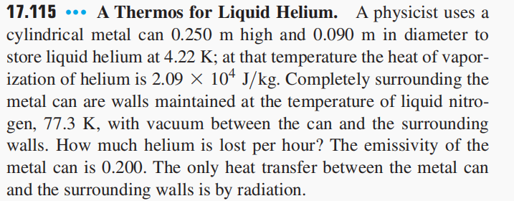

$$L_{v,helium}=20.9∗{10}^{3} J/kg$$
$$ΔL=L_{0}αΔT$$
$$ΔV=V_{0}βΔT, β=3α$$
$$Q=mcΔT$$
$$Q=±mL$$
$$H=kA\frac{\left(T_{H}−T_{C}\right)}{L}$$
$$H_{net}=Aeσ{(T}^{4}−T_{s}^{4})$$
$$σ=5.67 ∗{10}^{−8}W/m^{2}∗K^{4}$$

Slide 18
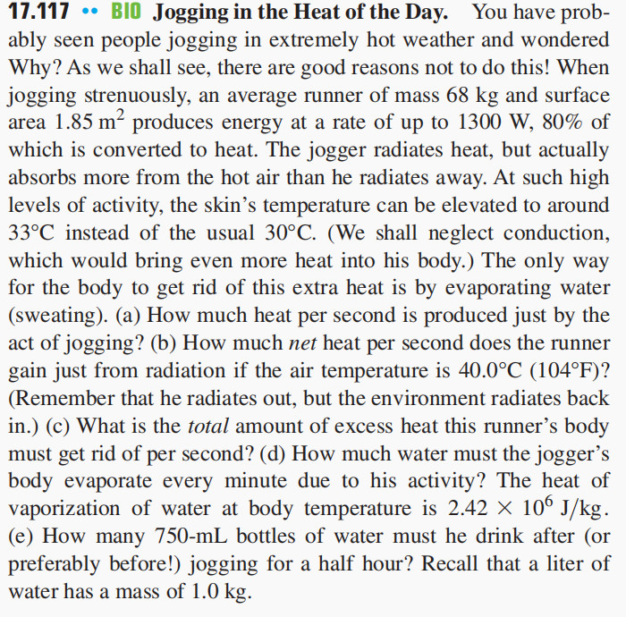
$$ΔL=L_{0}αΔT$$
$$ΔV=V_{0}βΔT, β=3α$$
$$Q=mcΔT$$
$$Q=±mL$$
$$H=kA\frac{\left(T_{H}−T_{C}\right)}{L}$$
$$H_{net}=Aeσ{(T}^{4}−T_{s}^{4})$$
$$σ=5.67 ∗{10}^{−8}W/m^{2}∗K^{4}$$

Slide 19
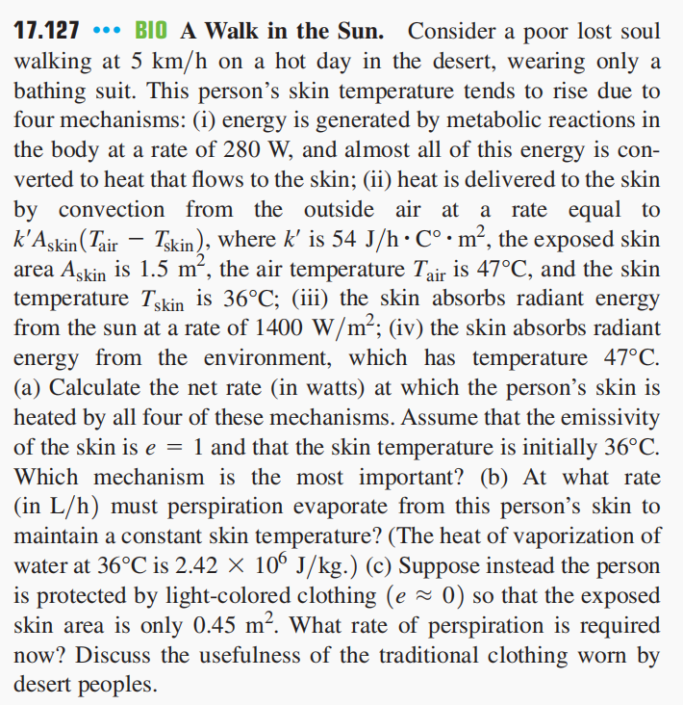
$$ΔL=L_{0}αΔT$$
$$ΔV=V_{0}βΔT, β=3α$$
$$Q=mcΔT$$
$$Q=±mL$$
$$H=kA\frac{\left(T_{H}−T_{C}\right)}{L}$$
$$H_{net}=Aeσ{(T}^{4}−T_{s}^{4})$$
$$σ=5.67 ∗{10}^{−8}W/m^{2}∗K^{4}$$

Slide 20
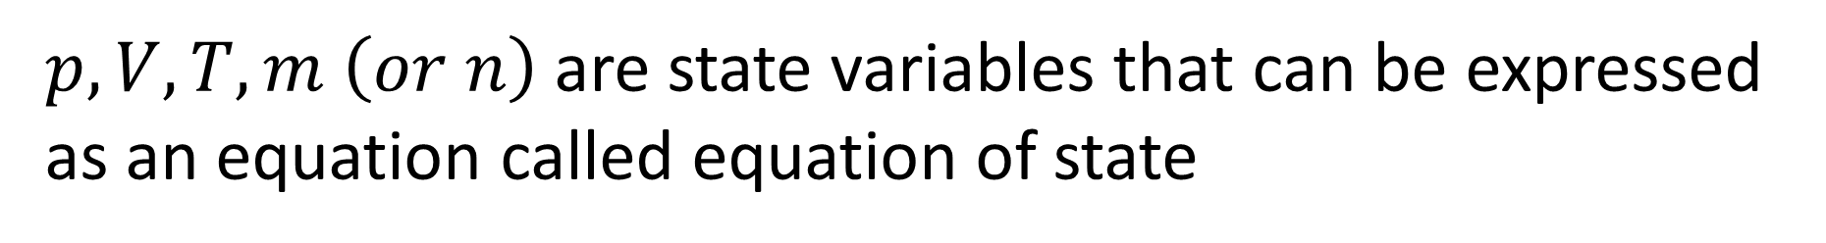
$p,V,T,m \left(or n\right)$ are state variables that can be expressed as an equation called equation of state

Slide 21
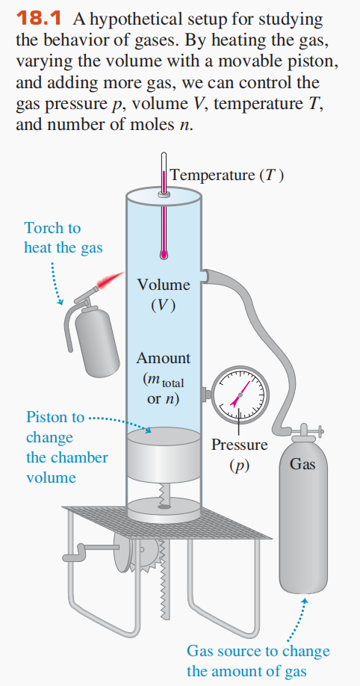
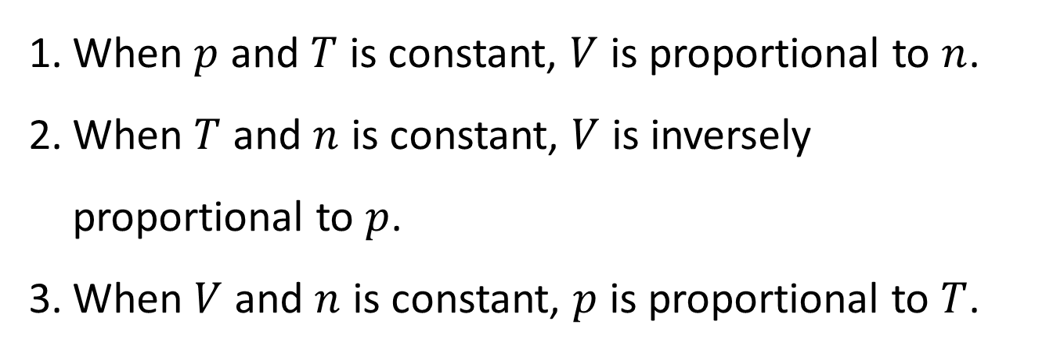
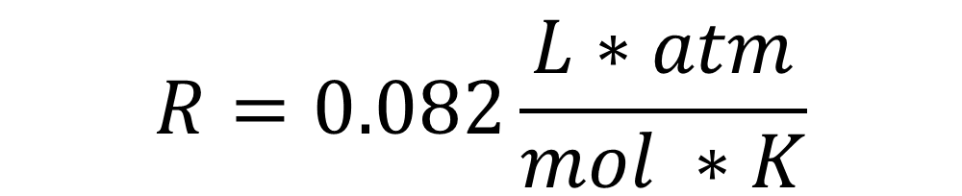

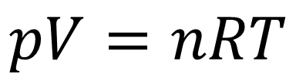
When $p$ and $T$ is constant, $V$ is proportional to $n$.
When $T$ and $n$ is constant, $V$ is inversely proportional to $p$.
When $V$ and $n$ is constant, $p$ is proportional to $T$.
$$pV=nRT$$
$$R=8.314 J/mol∗K$$
$$R=0.082\frac{L∗atm}{mol ∗K}$$

Slide 22
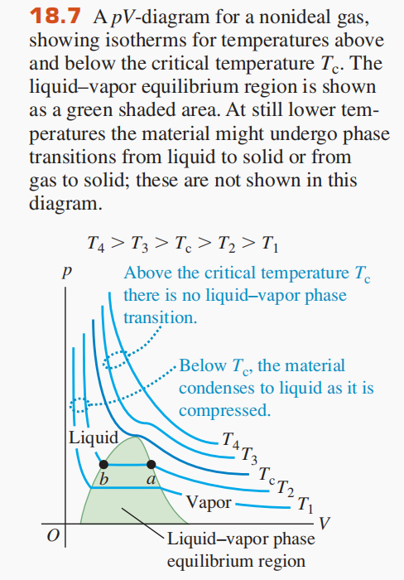
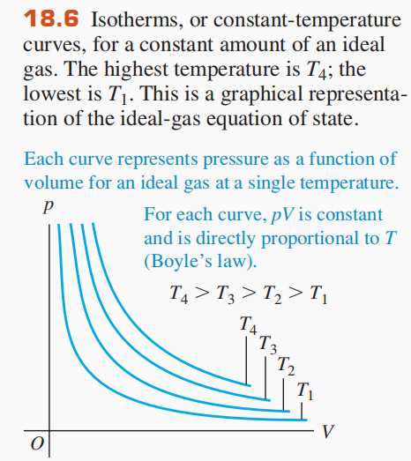

Slide 23
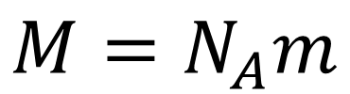
One mole is the amount of substance that contains as many elementary entities as there are atoms in 0.012 kilogram of carbon-12.
$$N_{A}=6.022∗{10}^{23}{molecules}/{mol}$$
$$M=N_{A}m$$

Slide 24
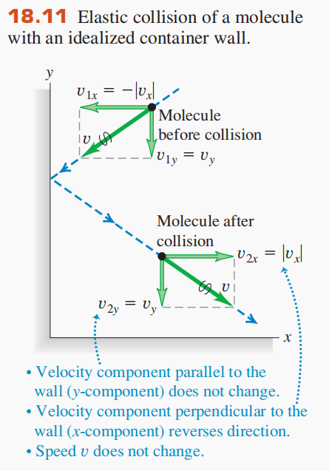
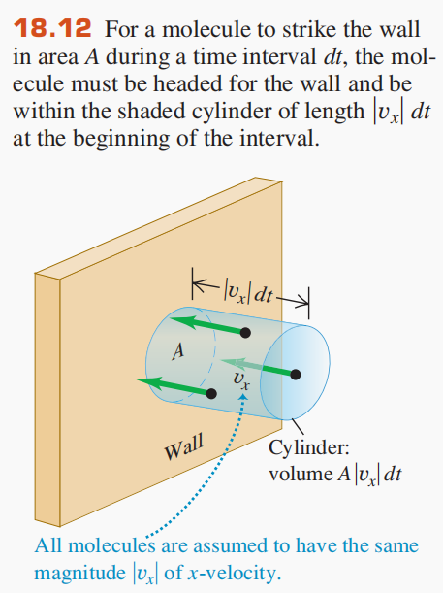
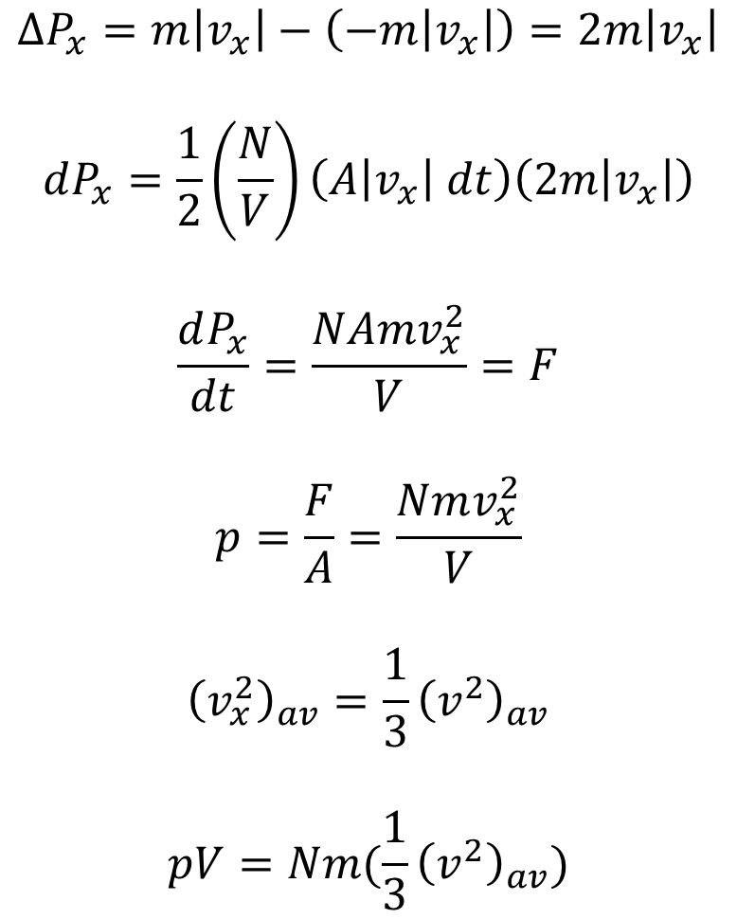
$$ΔP_{x}=m\left|v_{x}\right|−\left(−m\left|v_{x}\right|\right)=2m\left|v_{x}\right|$$
$$dP_{x}=\frac{1}{2}\left(\frac{N}{V}\right)\left(A\left|v_{x}\right| dt\right)\left(2m\left|v_{x}\right|\right)$$
$$\frac{dP_{x}}{dt}=\frac{NAmv_{x}^{2}}{V}=F$$
$$p=\frac{F}{A}=\frac{Nmv_{x}^{2}}{V}$$
$${\left(v_{x}^{2}\right)}_{av}=\frac{1}{3}{\left(v^{2}\right)}_{av}$$
$$pV=Nm(\frac{1}{3}{\left(v^{2}\right)}_{av})$$

Slide 25
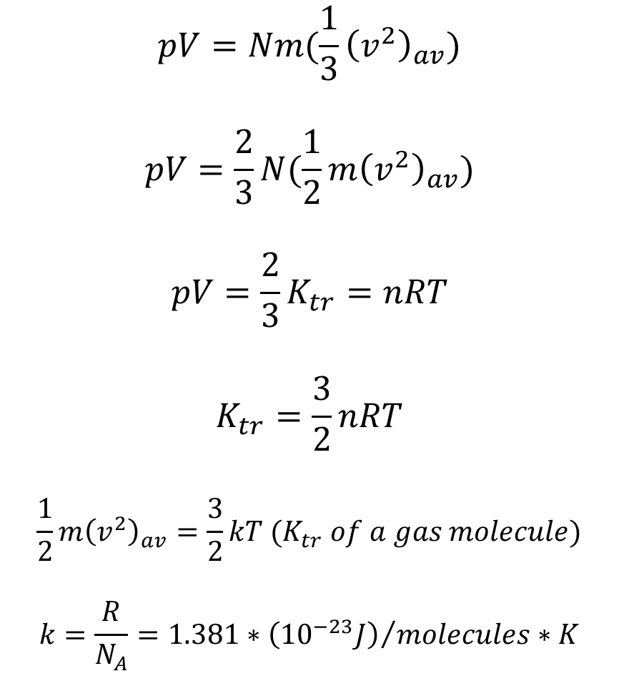
$$pV=Nm(\frac{1}{3}{\left(v^{2}\right)}_{av})$$
$$pV=\frac{2}{3}N(\frac{1}{2}m{\left(v^{2}\right)}_{av})$$
$$pV=\frac{2}{3}K_{tr}=nRT$$
$$K_{tr}=\frac{3}{2}nRT$$
$$\frac{1}{2}m{\left(v^{2}\right)}_{av}=\frac{3}{2}kT (K_{tr} of a gas molecule)$$
$$k=\frac{R}{N_{A}}=1.381∗{\left({10}^{−23}J\right)}/{molecules}∗K$$

Slide 26
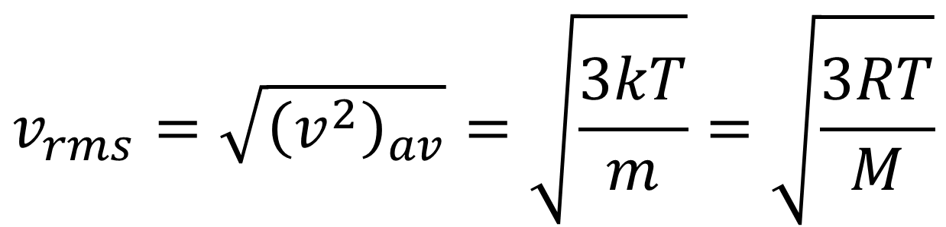
$$v_{rms}=\sqrt{{\left(v^{2}\right)}_{av}}=\sqrt{\frac{3kT}{m}}=\sqrt{\frac{3RT}{M}}$$

Slide 27
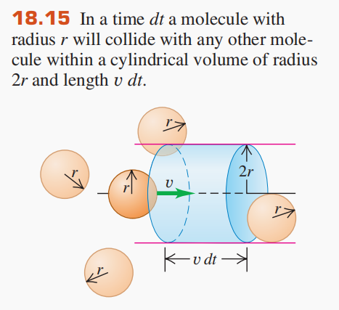
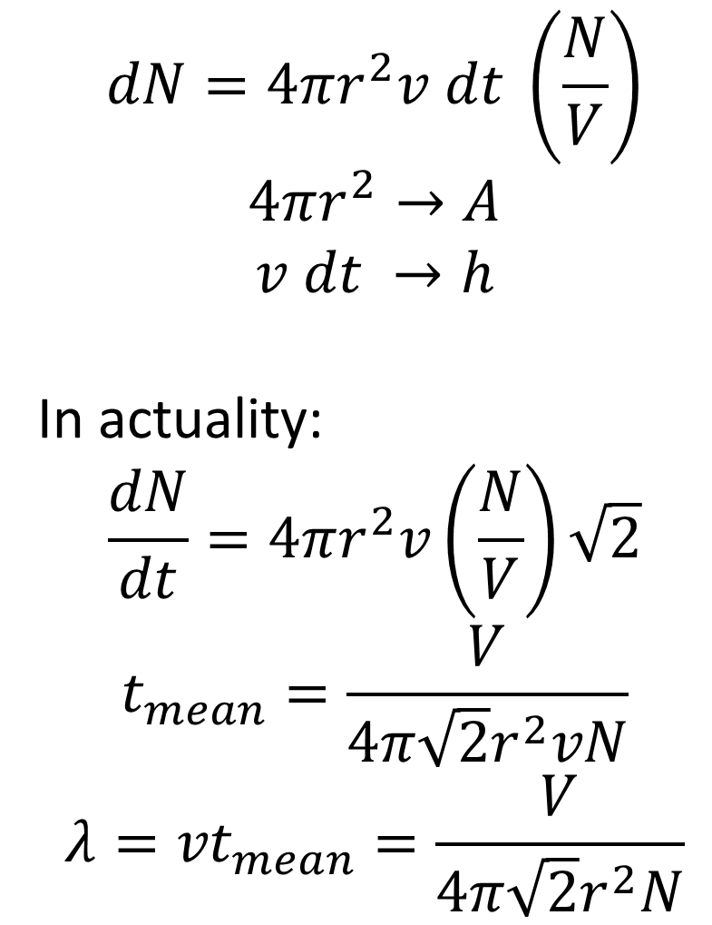
$$dN=4πr^{2}v dt \left(\frac{N}{V}\right)$$
$$4πr^{2}→A$$
$$v dt →h$$
In actuality:
$$\frac{dN}{dt}=4πr^{2}v\left(\frac{N}{V}\right)\sqrt{2}$$
$$t_{mean}=\frac{V}{4π\sqrt{2}r^{2}vN}$$
$${λ=vt}_{mean}=\frac{V}{4π\sqrt{2}r^{2}N}$$

Slide 28



$$dK_{tr}=\frac{3}{2}nR dT$$
$$dQ=nC_{V} dT$$
$$dK_{tr}=dQ$$
$$\frac{3}{2}nR dT=nC_{V} dT$$
$$C_{V}=\frac{3}{2}R=12.47{ J}/{mol}∗K$$

Slide 29



$$C_{V}=3R=24.9J/{mol}∗K$$

Slide 30



$$f\left(v\right)=4π{\left(\frac{m}{2πkT}\right)}^{\frac{3}{2}}v^{2}e^{−\frac{mv^{2}}{2kT}}$$

Slide 31


Slide 32


$$pV=nRT$$
$$R=8.314 J/mol∗K$$
$$1 atm=1.013 ∗{10}^{5}Pa$$
$$N_{A}=6.022∗{10}^{23}{molecules}/{mol}$$
$$M=N_{A}m$$
$$K_{tr}=\frac{3}{2}nRT$$
$$v_{rms}=\sqrt{\frac{3kT}{m}}=\sqrt{\frac{3RT}{M}}$$
$$k=1.381∗{\left({10}^{−23}J\right)}/{molecules}∗K$$

Slide 33

$$pV=nRT$$
$$R=8.314 J/mol∗K$$
$$1 atm=1.013 ∗{10}^{5}Pa$$
$$N_{A}=6.022∗{10}^{23}{molecules}/{mol}$$
$$M=N_{A}m$$
$$K_{tr}=\frac{3}{2}nRT$$
$$v_{rms}=\sqrt{\frac{3kT}{m}}=\sqrt{\frac{3RT}{M}}$$
$$k=1.381∗{\left({10}^{−23}J\right)}/{molecules}∗K$$

Slide 34

$$pV=nRT$$
$$R=8.314 J/mol∗K$$
$$1 atm=1.013 ∗{10}^{5}Pa$$
$$N_{A}=6.022∗{10}^{23}{molecules}/{mol}$$
$$M=N_{A}m$$
$$K_{tr}=\frac{3}{2}nRT$$
$$v_{rms}=\sqrt{\frac{3kT}{m}}=\sqrt{\frac{3RT}{M}}$$
$$k=1.381∗{\left({10}^{−23}J\right)}/{molecules}∗K$$

Slide 35

$$pV=nRT$$
$$R=8.314 J/mol∗K$$
$$1 atm=1.013 ∗{10}^{5}Pa$$
$$N_{A}=6.022∗{10}^{23}{molecules}/{mol}$$
$$M=N_{A}m$$
$$K_{tr}=\frac{3}{2}nRT$$
$$v_{rms}=\sqrt{\frac{3kT}{m}}=\sqrt{\frac{3RT}{M}}$$
$$k=1.381∗{\left({10}^{−23}J\right)}/{molecules}∗K$$

Slide 36




$$W=\int_{V_{1}}^{V_{2}}{p dV}$$
Work done in volume change

Slide 37


Work is dependent on path taken

Slide 38


Heat is also dependent on path taken

Slide 39




$$ΔU=Q−W$$
The first law of thermodynamics
$ΔU$ is independent of path taken
$ΔU$ is dependent only on the state of a system
$$dU=dQ−dW$$

Slide 40

Adiabatic process:
$$Q=0→ΔU=−W$$
Isochoric process:
$$ΔV=0 →W=0→ΔU=Q$$
Isobaric process:
$$W=PΔV$$
Isothermal process:
$$ΔT=0→ΔU=0 \left(for ideal gas\right)→Q=W$$

Slide 41

The internal energy of an ideal gas depends only on its temperature.
For nonideal gases, some temperature change occurs during free expansion, even though the internal energy is constant.

Slide 42


$C_{V}:$molar heat capacity at constant volume
$C_{P}:$ molar heat capacity at constant pressure
Isochoric process:
$$dQ=nC_{V} dT, dU=nC_{V} dT$$
Isobaric process:
$$dQ=nC_{P} dT, dW=p dV=nR dT$$
$$dU=dQ−dW$$
$$nC_{V} dT=nC_{P} dT−nR dT$$
$$C_{V}=C_{P}−R$$
$$γ=\frac{C_{P}}{C_{V}}>1$$

Slide 43


Adiabatic Process
$$dU=−dW$$
$$nC_{V} dT=−p dV$$
$$\frac{dT}{T}+\left(γ−1\right)\frac{dV}{V}=0$$
$$TV^{γ−1}=C$$
$$W=−ΔU=−nC_{V}ΔT$$
$$W=\frac{C_{V}}{R}(p_{1}V_{1}−p_{2}V_{2})$$
$$W=\frac{1}{γ−1}(p_{1}V_{1}−p_{2}V_{2})$$
Note: all these equations are only for ideal gas

Slide 44


$$W=\int_{V_{1}}^{V_{2}}{p dV}$$
$$ΔU=Q−W$$
Adiabatic process: $Q=0→ΔU=−W$
Isochoric process: $ΔV=0 →W=0→ΔU=Q$
Isobaric process: $W=PΔV$
Isothermal process: $ΔT=0→ΔU=0 \left(for ideal gas\right)→Q=W$
$$C_{V}=C_{P}−R$$
$$R=8.314 J/mol∗K$$
$$γ=\frac{C_{P}}{C_{V}}$$
$W=−ΔU=−nC_{V}ΔT$ (adiabatic)
$W=\frac{C_{V}}{R}\left(p_{1}V_{1}−p_{2}V_{2}\right)$ (adiabatic)

Slide 45

$$W=\int_{V_{1}}^{V_{2}}{p dV}$$
$$ΔU=Q−W$$
Adiabatic process: $Q=0→ΔU=−W$
Isochoric process: $ΔV=0 →W=0→ΔU=Q$
Isobaric process: $W=PΔV$
Isothermal process: $ΔT=0→ΔU=0 \left(for ideal gas\right)→Q=W$
$$C_{V}=C_{P}−R$$
$$R=8.314 J/mol∗K$$
$$γ=\frac{C_{P}}{C_{V}}$$
$W=−ΔU=−nC_{V}ΔT$ (adiabatic)
$W=\frac{C_{V}}{R}\left(p_{1}V_{1}−p_{2}V_{2}\right)$ (adiabatic)

Slide 46


$$W=\int_{V_{1}}^{V_{2}}{p dV}$$
$$ΔU=Q−W$$
Adiabatic process: $Q=0→ΔU=−W$
Isochoric process: $ΔV=0 →W=0→ΔU=Q$
Isobaric process: $W=PΔV$
Isothermal process: $ΔT=0→ΔU=0 \left(for ideal gas\right)→Q=W$
$$C_{V}=C_{P}−R$$
$$R=8.314 J/mol∗K$$
$$γ=\frac{C_{P}}{C_{V}}$$
$W=−ΔU=−nC_{V}ΔT$ (adiabatic)
$W=\frac{C_{V}}{R}\left(p_{1}V_{1}−p_{2}V_{2}\right)$ (adiabatic)

Slide 47

$$W=\int_{V_{1}}^{V_{2}}{p dV}$$
$$ΔU=Q−W$$
Adiabatic process: $Q=0→ΔU=−W$
Isochoric process: $ΔV=0 →W=0→ΔU=Q$
Isobaric process: $W=PΔV$
Isothermal process: $ΔT=0→ΔU=0 \left(for ideal gas\right)→Q=W$
$$C_{V}=C_{P}−R$$
$$R=8.314 J/mol∗K$$
$$γ=\frac{C_{P}}{C_{V}}$$
$W=−ΔU=−nC_{V}ΔT$ (adiabatic)
$W=\frac{C_{V}}{R}\left(p_{1}V_{1}−p_{2}V_{2}\right)$ (adiabatic)

Slide 48

$$W=\int_{V_{1}}^{V_{2}}{p dV}$$
$$ΔU=Q−W$$
Adiabatic process: $Q=0→ΔU=−W$
Isochoric process: $ΔV=0 →W=0→ΔU=Q$
Isobaric process: $W=PΔV$
Isothermal process: $ΔT=0→ΔU=0 \left(for ideal gas\right)→Q=W$
$$C_{V}=C_{P}−R$$
$$R=8.314 J/mol∗K$$
$$γ=\frac{C_{P}}{C_{V}}$$
$W=−ΔU=−nC_{V}ΔT$ (adiabatic)
$W=\frac{C_{V}}{R}\left(p_{1}V_{1}−p_{2}V_{2}\right)$ (adiabatic)

Slide 49



